Slide 1
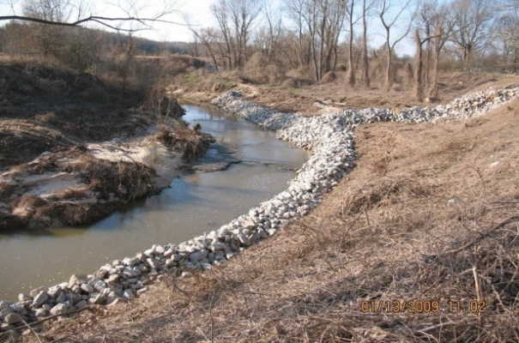
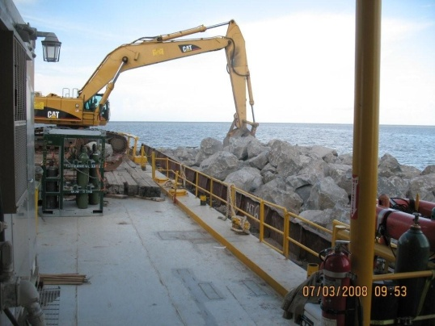
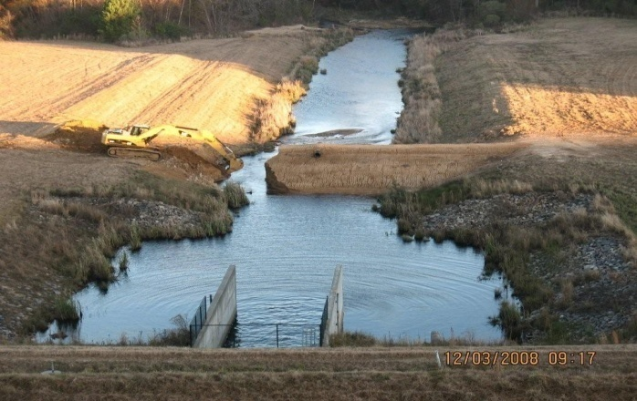
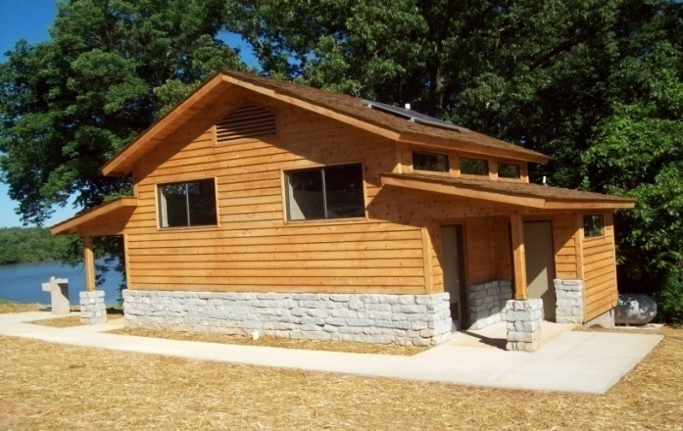
Dependable and Reliable

Slide 2
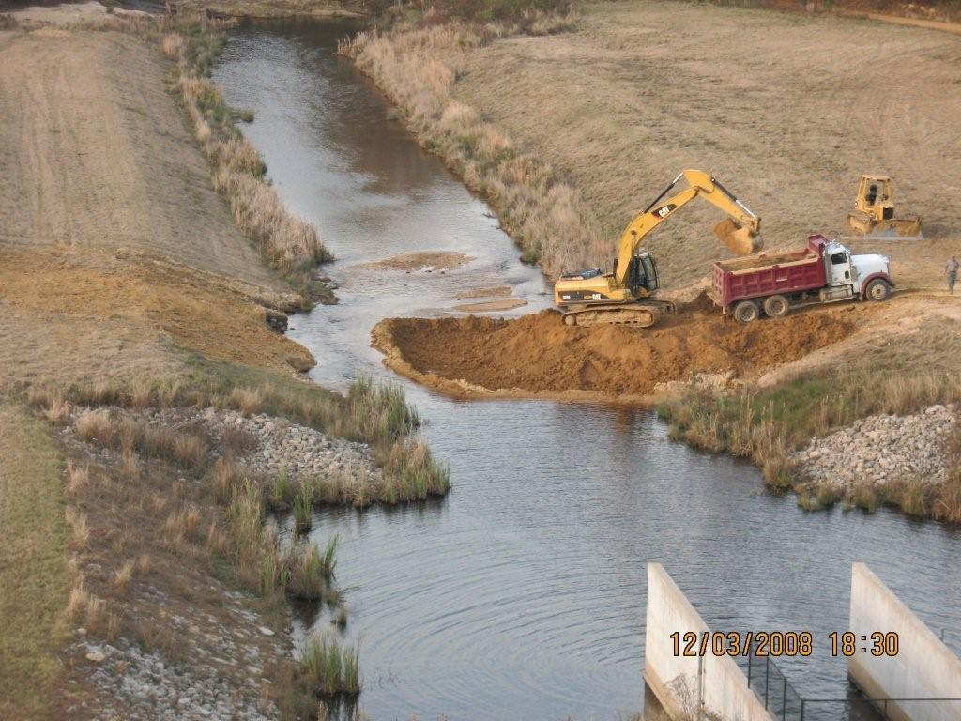
Rexal Heidelberg – President
Mobile: (601) 218-4419
Email: trucklaservices@aol.com
1411 Cherry St Suite 102
PO Box 821711
Vicksburg, Ms 39180
Office:(601) 619-9300
Fax: (601) 619-9301
Visit us @ www.truckla.com
NRCS Franklin County

Slide 3
CAPABILITIES
Truckla Services is a minority-owned, small business that specializes in construction and services.
From inception, Truckla Services, Incorporated has expanded our capabilities and grown in size and responsibilities. We have increased our management strengths and technical capabilities through careful recruitment and assignment in areas of expertise. With our forward looking company goals and attention to detail, we have grown from a very small business to a reputable business providing solutions to various government solicitations both as a prime contractor and as a subcontractor.
Our progression has taken us on an amazing journey with the Department of Interior, the U. S. Army Corps of Engineers, the State of Mississippi Soil and Water Conservation Service, the Katrina Disaster, and the Federal Emergency Management Agency, and the Department of Homeland Security. We have grown from logistics transportation to erecting the largest metal building in the history of the Federal Emergency Management Agency.

Slide 4
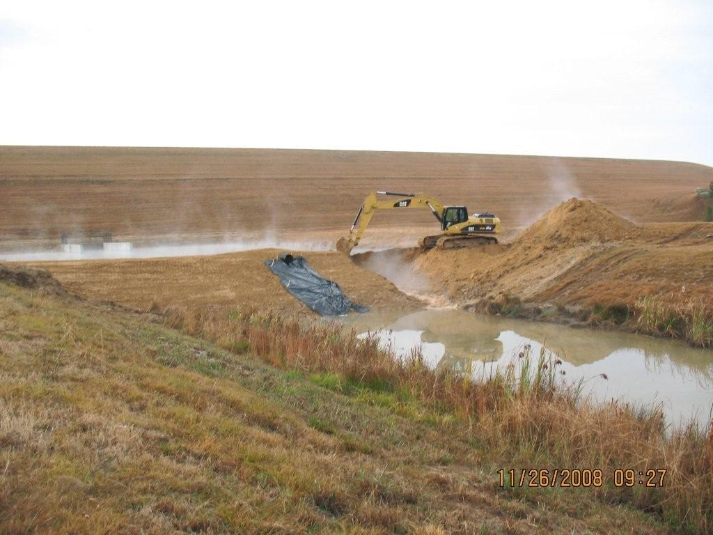
…CONT
We have demonstrated our expertise in the following areas:
Levee Surface Restoration
Dam Restoration
Restoration of statues and monuments
Security Bollards and Cables
Demolition of Buildings and Parking Lots
Remodeling and Renovation of Historical Buildings
Erosion Control
Establishing and Building of Firebreaks
Painting
Drayage
Asbestos Abatement
Drainage Systems
Prefabricated Building
Electrical Systems
Foundation Systems
HVAC, Installation and Upgrade
Logistics
Armor Stone Rock Jetty Construction
NRCS Franklin County

Slide 5
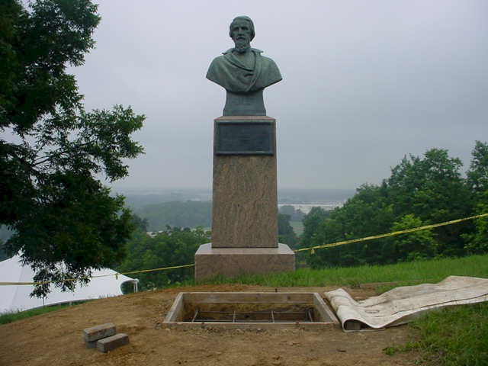
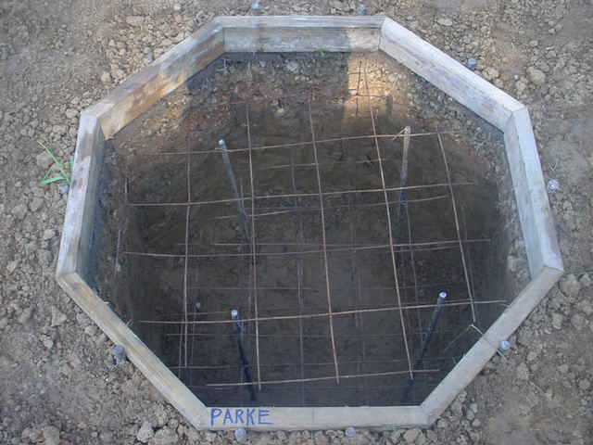
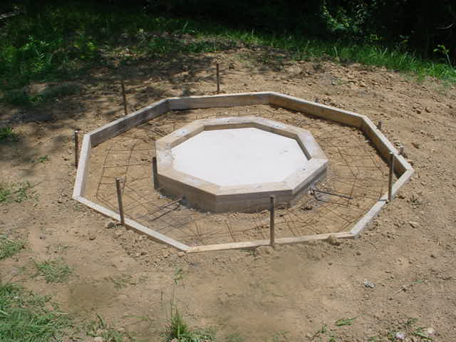
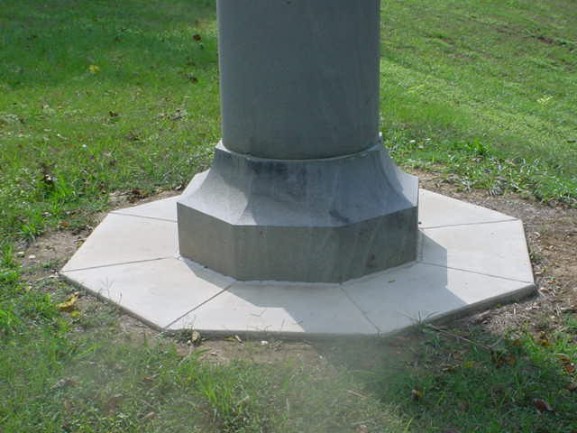
VICKSBURG MILITARY PARK
VICKSBURG MILITARY PARK
Contract # Q5600060155
Vicksburg National Military Park (WUI thinning project)
11/06-03/07
Contract # Q5600060120
Vicksburg National Military Park (VC electrical connection)
11/06-01/07
Contract # Q5600040177
Vicksburg National Military Park (Erosion on graveyard and Fort Hill Dr.)
06/04-09/04
Contract # Q5600060214
Vicksburg National Military Park
08/06-10/06
(Bollards & Cables @ Fort Hill)
Contract # P5603080012
National Park Service/Department of Interior (Removal of vegetation from Logue’s Meadow)
02/08-03/08
Contract # P5603080012
National Park Service/Department of Interior (Removal of vegetation from Graveyard Rd.)
01/08-02/08

Slide 6
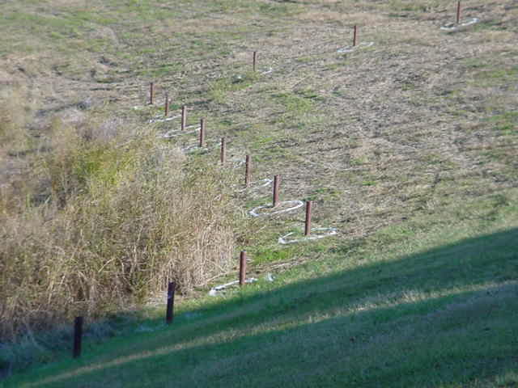
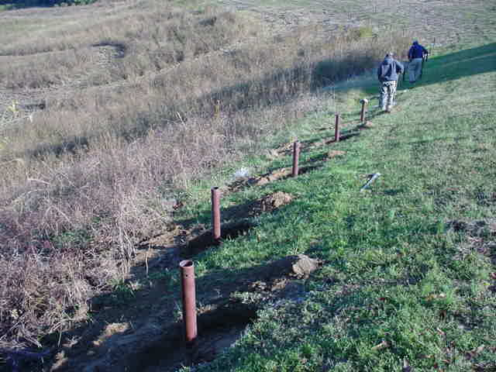
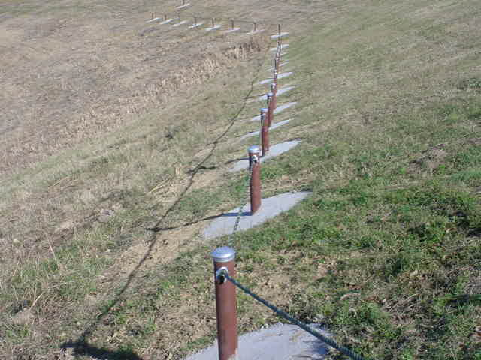
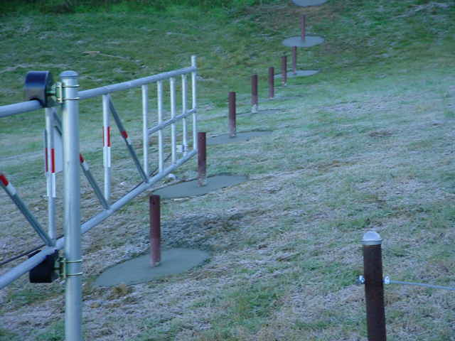
VICKSBURG MILITARY PARK
Contract # Q5600060214
Vicksburg National Military Park
08/06-10/06
(Place Bollards & Cables @ Fort Hill)

Slide 7
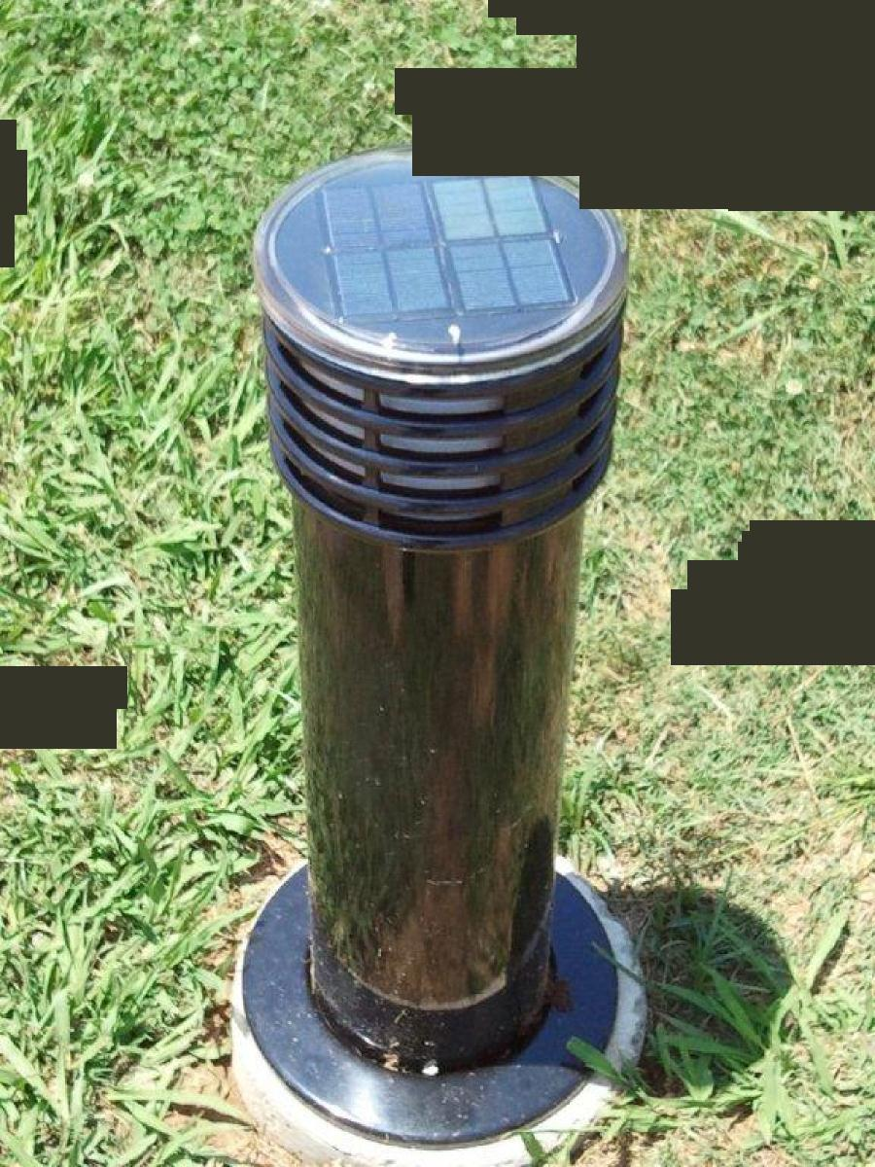
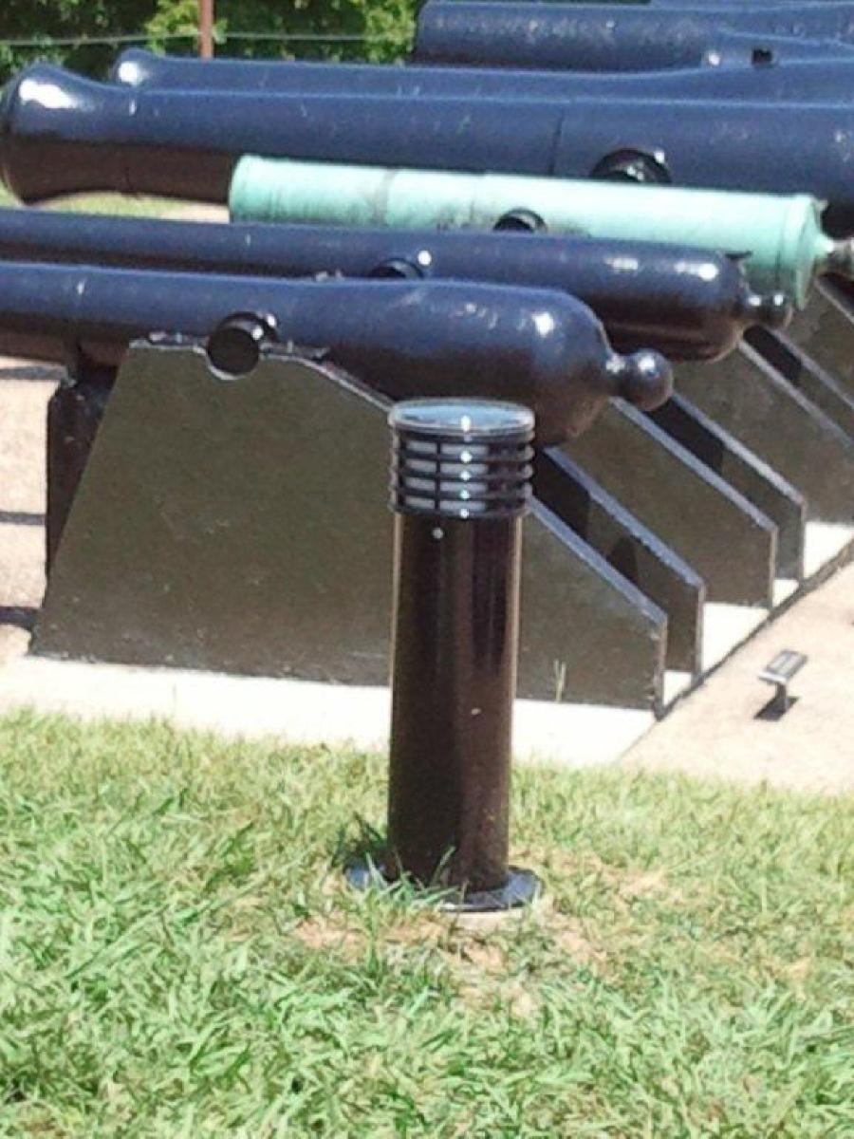
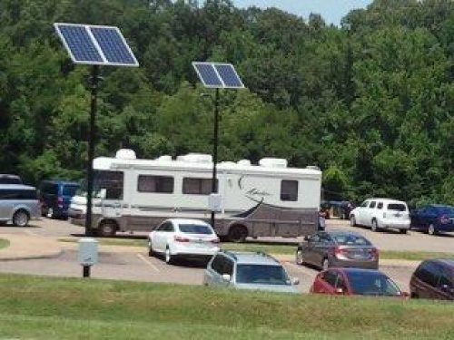
VICKSBURG MILITARY PARK
Contract # P12PC00185
Vicksburg National Military Park
4/12-5/12
(Installation of Bollards and Solar
Parking lot Lights/Poles)
“Go Green”
Solar parking lot lights are eco friendly, require no maintenance
and are long lasting. Also, they are economical, hassle
free, and the bulbs do not need changing. The sun is the only energy
required and it’s free.

Slide 8
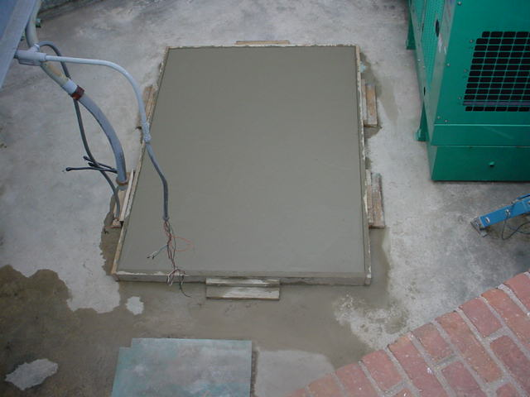
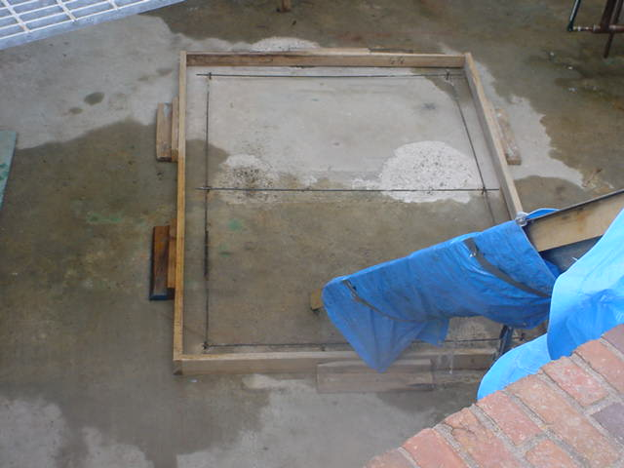
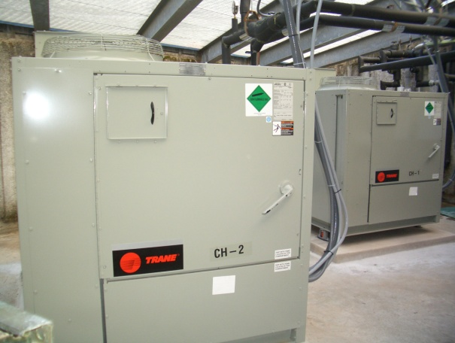
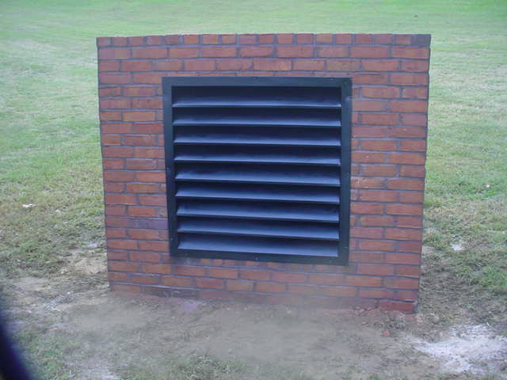
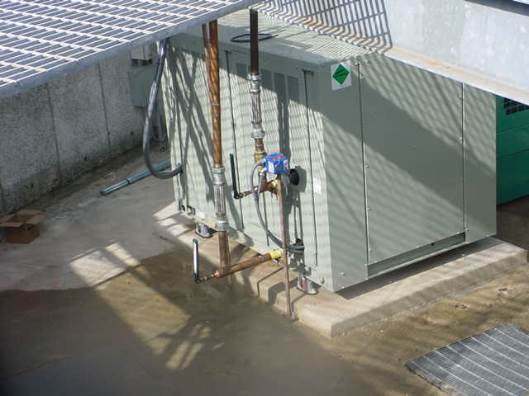
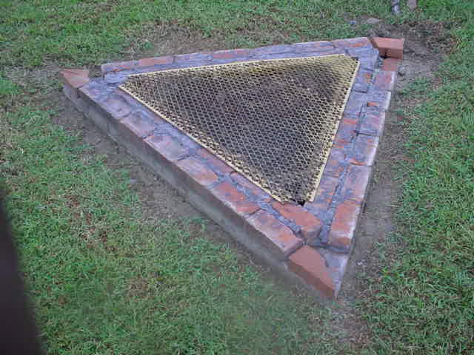
Cairo Museum National Park Service

Slide 9
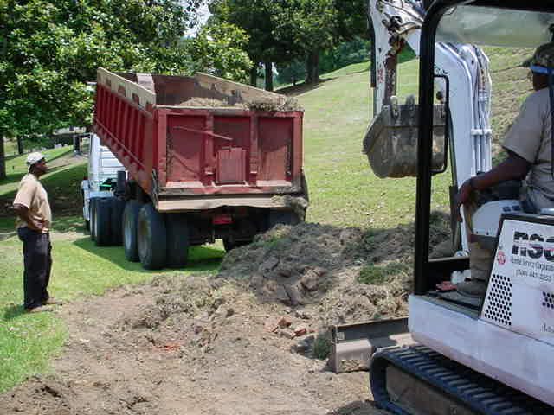
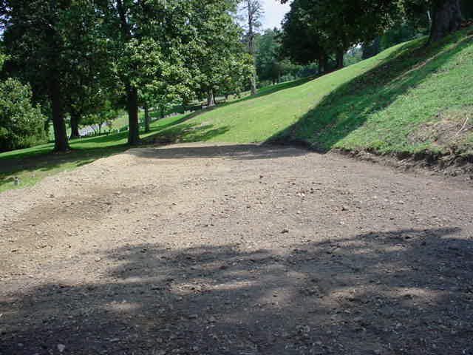
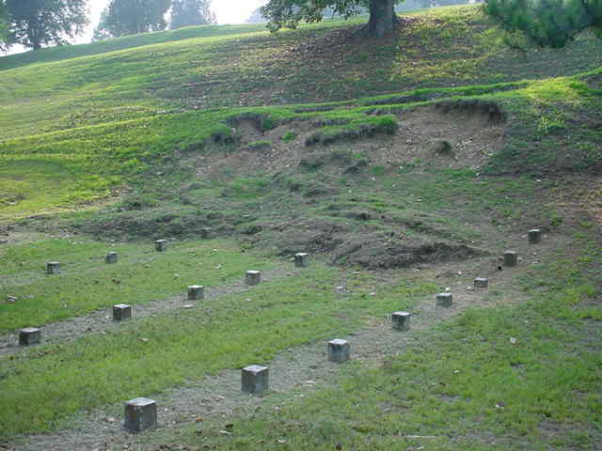
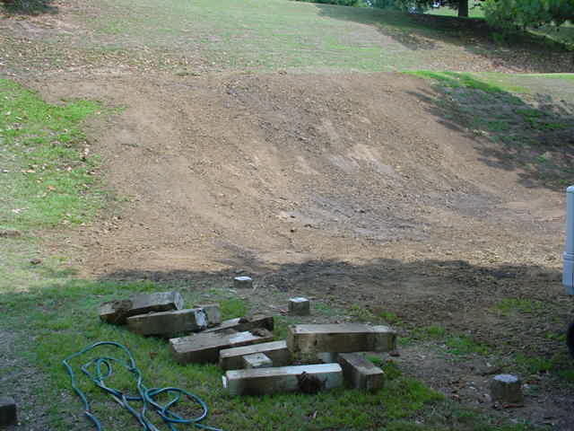
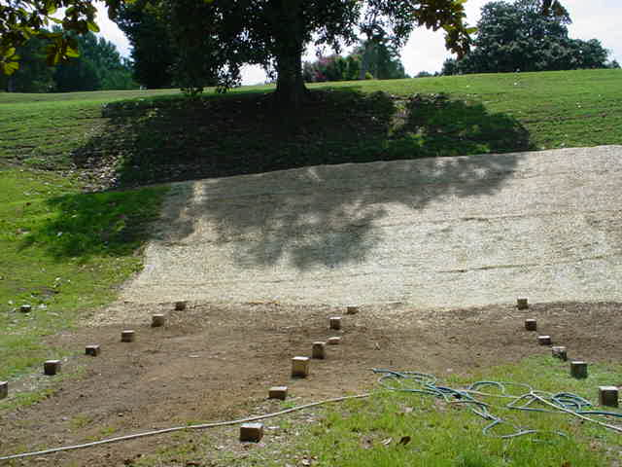
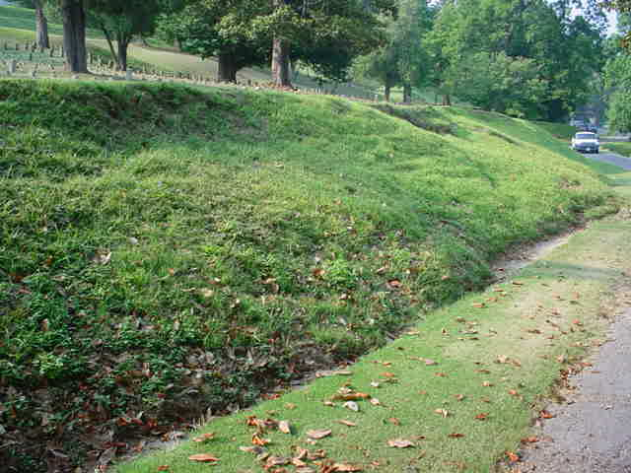
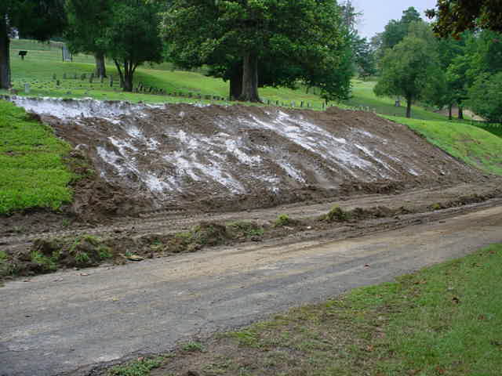
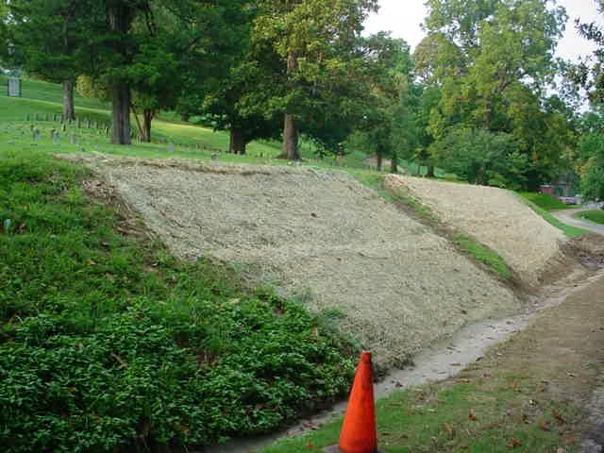
Contract # Q5600040177
Vicksburg National Military Park
(Erosion on graveyard and Fort Hill Dr.)
06/04-09/04

Slide 10
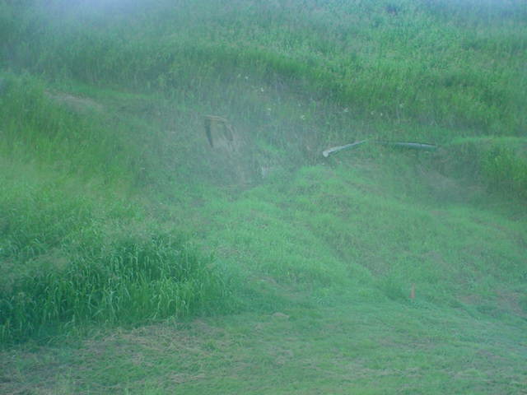
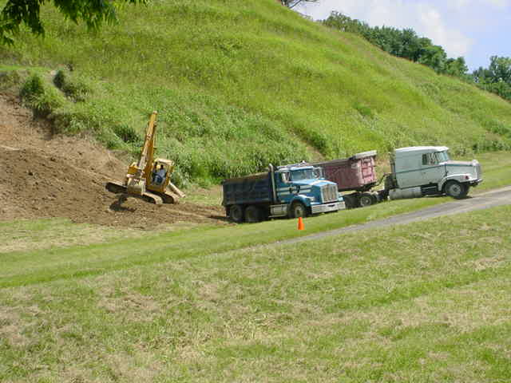
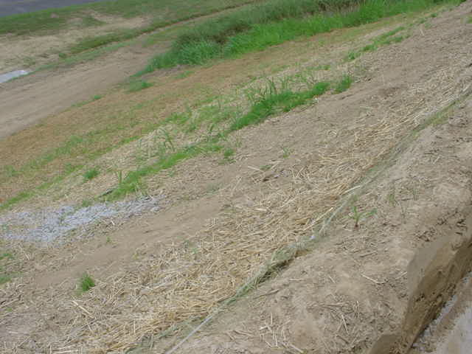
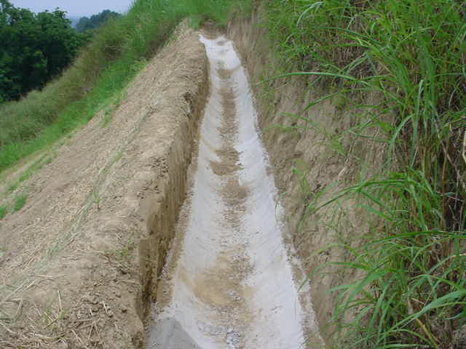
…CONT
Contract # Q5600040177
Vicksburg National Military Park
(Erosion on graveyard and Fort Hill Dr.)
06/04-09/04

Slide 11
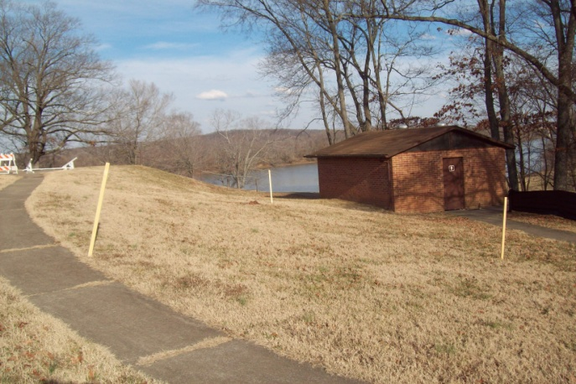
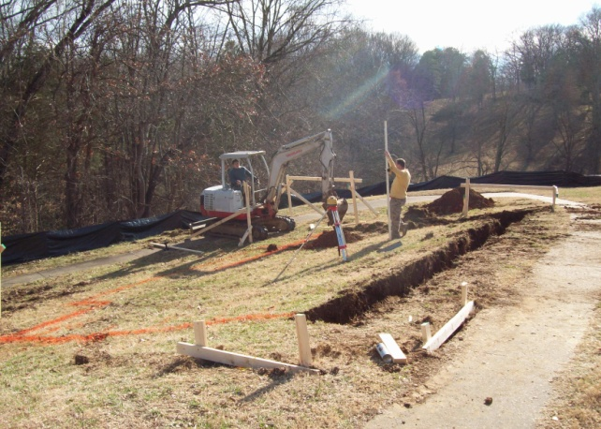
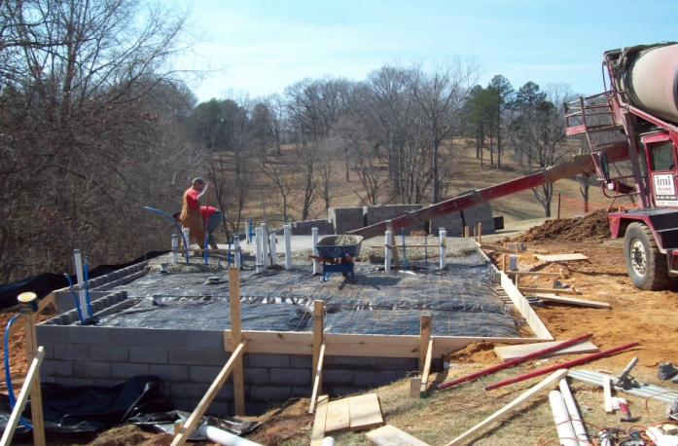
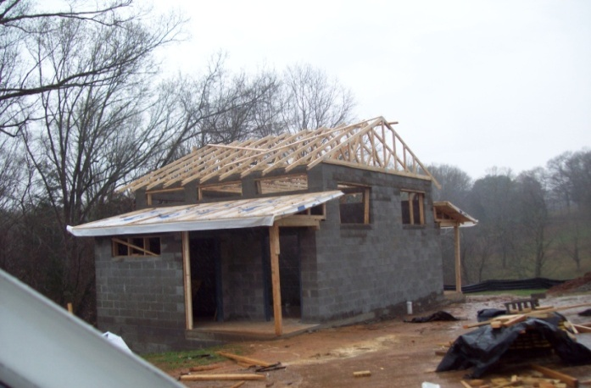
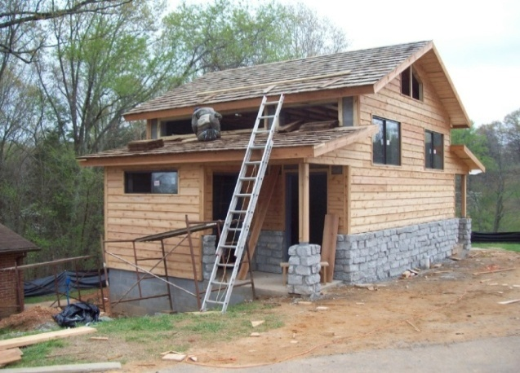
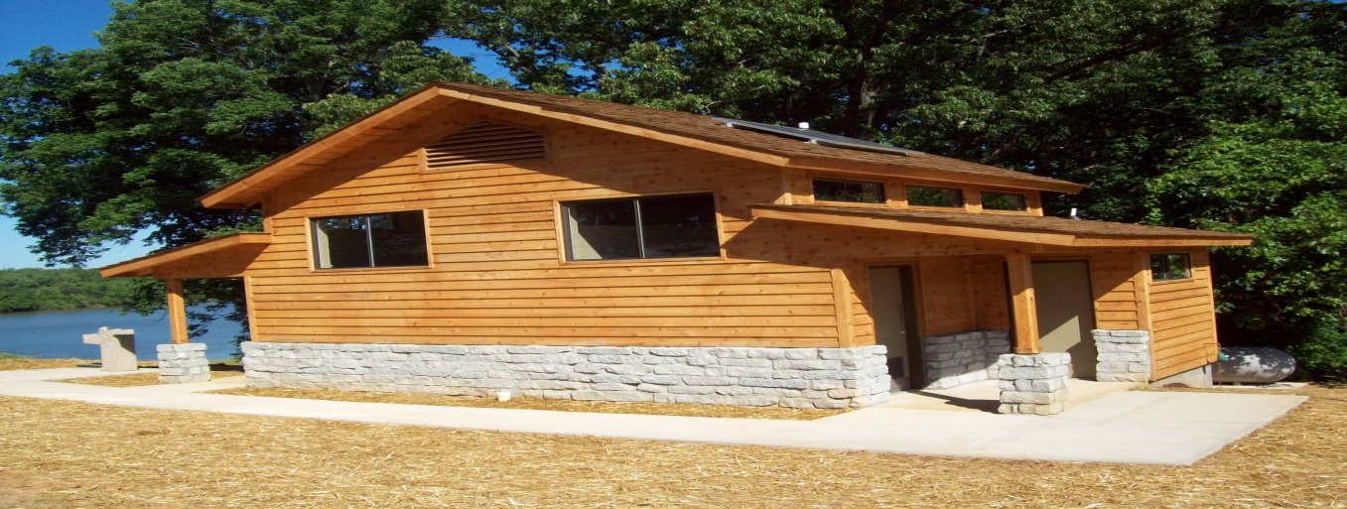
Fort Donelson
Contract #: N5600080006
National Park Service
Ft. Donelson Comfort Station
Starting Date: 1/09 – 6/09

Slide 12
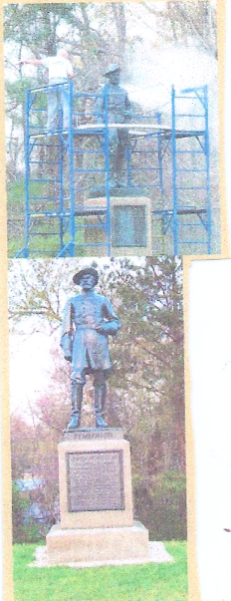
…CONT
Contract # C56000050167
National Park Service/Department of Interior (Rehabilitation of park ad/min building)
07/06-12/06
Contract # P560050145
National Park Service/Department of Interior (Repair storm damage)
06/05-08/05
Contract # P5600040151
National Park Service/Department of Interior (Firebreak on S. Loop of Boundary)
10/06-01/07
Contract # P5600070065
National Park Service/Department of Interior
(WUI Thinning project)
08/06-11/06
Contract # P560005A179
National Park Service/Department of Interior (Asbestos removal/Demolition)
07/05-09/05
Contract # P5600040310
National Park Service/Department of Interior (Maintenance)
12/04-01/05

Slide 13
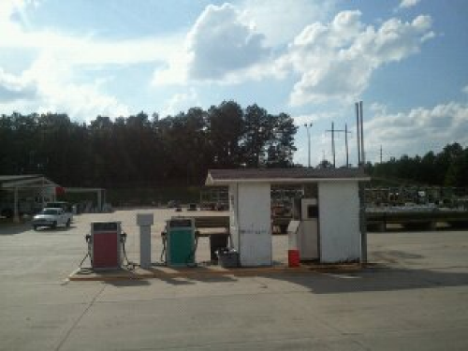
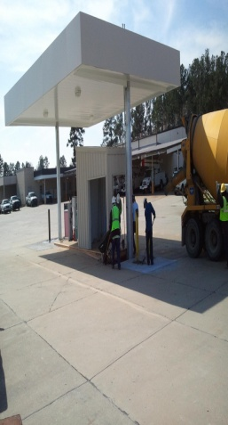
…CONT
Contract # P5603080012
National Park Service/Department of Interior (Vegetation removal)
01/08-02/08
Contract # 3031036218
Vicksburg National Military Park
(Footings & Landscaping)
6/2008-11/2008
8/2008-11/2008
Contract #
Vicksburg National Military Park (Concrete footing & retaining wall, landscaping)
05/08-07/08
Contract # P5600040136
National Park Service/Department of Interior (Concrete aprons for bus)
03/04-09/05
Contract # C5600040214
National Park Service/Department of Interior
(HVAC)
10/04-01/05

Slide 14
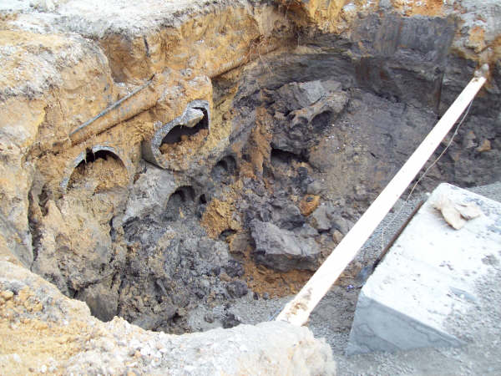
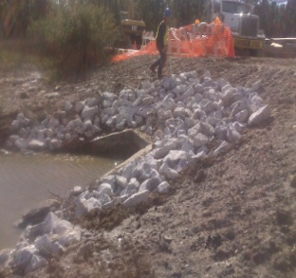
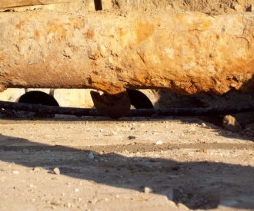
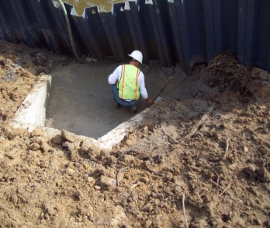
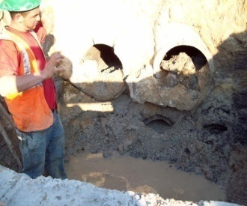
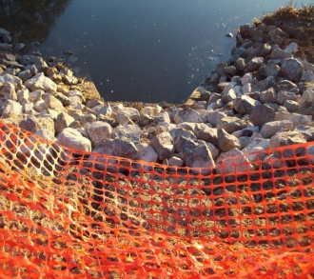
Gulf Island National Park
Contract # 1443C2011080572
National Park Service, Ocean Springs, MS (Culvert Replacement/Fence Repair)
10/2008- 1/2009
Contract # R5605080064
Vicksburg National Military Park , (Stone and Bronze conservation)

Slide 15
National Park Service, Driveway, Fencing and Brick Walk
Contract # C5605-08-0055
Vicksburg National Military Park (Repair of Pemberton’s Headquarters)
8/2008 - 11/2008

Slide 16
Levee Contracts
Contract # W912EE-06-C-0029
SCK Trucking (Limestone Placement on levee)
Starting Date: 10/06-11/06
Contract # W912EE-06-R-0015
Henderson Construction
(Limestone Placement on levee)
Starting Date: 09/06-10/06
Contract # W912EE-07-T-0038
Bolivar County
(Placement of Crushed Stone on Levee)
9/07-10/07

Slide 17
CUMBERLAND, MARYLAND (FEMA)
Contract # HSFEHQ-06-C-0704
DHS/FEMA
(Erecting of a prefabricated building at the Cumberland Logistic Center)
09/06-03/07

Slide 18
CUMBERLAND, MARYLAND (FEMA DRAINAGE)
Contract # HSFEHQ-06-C-0701
DHS/FEMA
(Concrete slab drainage modifications for the Cumberland Logistic Center)
09/06-03/07

Slide 19
MORGAN CITY, LA (ATCHAFALAYA RIVER & BAYOUS CHENE BOEUF AND BLACK LOUISIANA, DCAS)
Contract # W912EE-07-C-0023
(Truckla Services, Subcontractor)
10/07 - 9/2008
Atchafalaya River and Bayous Chene, Boeuf, & Black Louisiana Demonstration Channel Alignment Structure (DCAS)
(Placing of Armor and Bedding stone in the Gulf of Mexico)

Slide 20
W912P9-09-D-0511(98.6) W912P9-09-D-0512(20.0)
US Army Corps of Engineers, St Louis
Dike and Revetment Work

Slide 21
National Resource Conservation Service
Contract # AG-7217-D-07-0056
Channel Slope Repair (Barataria Outfall)
07/07-04/08
Contract # AG-7217-D-07-0057
Channel Slope Repair #3
06/07-08/07
Contract # AG-7217-D-07-0063
Channel Slope Repair Heebe
06/07-05/08
Contract # AG-7217-D-07-0064
Channel Slope Repair Verret site 1
06/07-04/08
Contract # AG-7217-D-07-0071
Channel Slope Repair Verret @ Fairfield
09/07-04/08
Contract # AG-7217-D-07-0072
Channel Slope Repair Chalmette Vista
07/07-08/07
Contract # AG-7217-D-07-0073
Channel Slope Repair Guichard
07/07-01/08

Slide 22
Contract # AG-5523-S-08-0015
Installation of blanket drain, seepage berm and construction,
removal of a coffer dam in the
outlet channel
11/2008- 1/2009

Slide 23
PERRY CREEK (Stabilization Work on Perry Creek in Grenada County, Mississippi)
Contract# W912EE-08-C-0018
Corps of Engineers
8/2008- 1/2009
FC/MR&T, Yazoo River Basin Batupan Bogue Watershed Grenada County, Mississippi, Mississippi Delta Headwaters Project Bank Stabilization-Perry Creek BS-04-02

Slide 24
Corps of Engineers, New Orleans
Contract # W912P8-09-T-0171
Concrete Helicopter Pad
Starting Date: 9/21/09 – 9/29/09

Slide 25
Calhoun County, MS Riser Pipe Grade Control Structures, RP-04-03
Contract# W912EE-09-C-0039
Corps of Engineers
Riser Pipe Grade Control Structures
10/17/09 - Present

Slide 26
Other Contracts
Contract # Q5600060155
WUI Thinning Project
Starting Date: 11/1/06 – 3/1/07
Contract # P5600060158
Headstone Cleaning
Starting Date: 6/2006 – 8/2006
Contract # AEC 046.08
Disposal and Removal
Starting Date: 4/8/2008
Contract # W912EE-09-P-0010
Stone Hauling
Starting Date: 11/2008 – 11/2008
Contract # P5600070065
Firebreak 2
Starting Date: 8/2006 – 11/2006
Contract # 1443C2011080572
Culvert Replacement
Starting Date: 10/2008 – 12/2008
Contract # P5600040310
Maintenance
Starting Date: 12/2004 – 1/2005
Contract # P560005A179
Asbestos
Starting Date: 7/2005 – 9/2005
Contract # 3031036218
Concrete footings/landscaping
Starting Date: 6/2008 – 11/2008
Contract # W912HZ-10-C-0040
ERDC Small Package Program
Starting Date: 3/1/10 – 5/31/11
Contract # W912EQ-10-C-0005
ERDC Freight
Starting Date: 3/1/10 – 5/31/11
Contract # P0009068
Holmes Community College (Furnish & Spray
Herbicide on Vegetation and school pond)
Starting Date: 4/06-05/06

Slide 27
Other Contracts
Contract # W912EE-04-C-0009
Army Corp of Eng,
(Duck Hill Erosion control)
Starting Date: 12/04-09/05
Contract # Y-19a-14
Mississippi Soil & Conservation (Rehabilitation of Dams)
Starting Date: 10/05-12/05
Contract # Y-19a-15
Mississippi Soil & Conservation (Rehabilitation of Dams)
Starting Date: 10/05-12/05
Contract # IHL206022
Mississippi Valley State University
(Install fence for soccer field, Security drive & Gate)
05/07-01/08
Contract # W912P8-08-C-0098
New Orleans, LA
(HVAC Unit replacement in daycare)
9/2008- 10/2008
Vicksburg National Military Park
Contract # R5605080064
Stone and bronze conservation
Installation of cast aluminum
Starting Date: 9/08 – 5/09
Contract # 25151-004-FC5-UA11-0009
Bechtel National, Inc.
(Transporting and deactivation of Travel Trailers
for Hurricane Katrina)
Starting Date: 11/05-04/06
Contract # W912EE-05-P-0237
Army Corp of Eng
(Logistics and Motor Pool)
Starting Date: 09/05-9/10
Contract # W912EE-09-P-0010
Army Corp of Eng
(C Stone Hauling)
Starting Date: 11/2008 – 1/2009
Contract # W912EE-09-P-0001
Army Corp of Eng
(HVAC System)
Starting Date: 4/12/08 – 3/2009
Contract# W912EE-09-P-0103
Rip Rap For Sulfur River
Starting Date: 5/09 – 6/09

Slide 28
Other Contracts
Contract # W912P8-09-P--0195
Replace Exterior Siding, Facia & Soffit
Starting Date: 5/09-7/09
Contract # W912P8-09-C-0107
HVAC Systems (Provide and Install)
Starting Date: 12/09-6/10
Contract # W912P8-09-T-0171
Concrete Helicopter Pad
Starting Date: 9/21/09 – 9/29/09
Contract # N7530090017
Crack Seal Concrete Roadways, Parking and Sidewalks
Starting Date: 10/10/09 - 11/20/09
Contract # W912P8-09-P-0223
Interior Office Modifications
Starting Date: 6/09-7/09
Contract # W912P8-10-C-0041
Bathroom Renovations
Starting Date: 1/10-7/10
Contract # W912EE-10-C-0004
Riser Pipe Grade Control Structures, RP-05-02
Starting Date: 3/10-12/10
Contract # W912P8-10-P-0037
Automatic Door Opener/Closer
Starting Date: 1/10-2/10
Contract # Q5605-10-0012
NPS Pemberton House (ADA Lift)
Starting Date: 12/09-5/10
Contract # W912P8-10-C-0044
Castle Kids Development Center (HVAC)
Starting Date: 2/10-5/10
Contract # W912P8-10-P-0060
Mail Room Modifications
Starting Date: 12/09-3/10
Contract # R5600050179
Demolition
Starting Date: 7/22/05 – 8/25/05
Contract # P5600040151
Firebreak along south loop of park boundary line
Starting Date: 10/2006 – 1/2007
Contract # N7530090017
Crack Seal Concrete Roadways, Parking and Sidewalks
Starting Date: 10/10/09 - 11/20/09

Slide 29
Other Contracts
Contract # W912EE-09-B-0030
Dike Revetment
Starting Date: 10/09-1/10
Contract #: W911S7-10-P-0261
Furniture Moving/Assembly
Start Date: 9/10-12/10
Contract #: W911S7-10-P-0254
Firebreak Start Date: 9/10-12/10
Contract #: C5580100003
Replacing Housing Shingles (NPS)
Start Date: 9/10-12/10
Contract # :W911S7-10-C-0053
New Office in Museum
Start Date: 9/26-Govt. Delay
Contract # :W911S7-10-C-0043
Construct Conference Room – 347
Start Date: 9/10-2/11
Contract # :W911S7-10-C-0042
Construct SIPR Vault-R00m 2617
Start Date: 9/10-2/11
Contract # :W911S7-10-C-0054
Relocate Transformer East End – Bldg 3201
Start Date: 10/10-4/11
Contract #: C951200090
Rehabilitate Restrooms
Start Date: 10/10-2/11
Contract #: C5603-11-0010
Install Post Fabricated Tablets
Start Date: 4/11-5/11
Contract # :W911S7-11-C-0006
Install Exit Signs
Start Date: 4/11-5/11
Contract #: W91278-11-D-0013
Clearing and Grubbing
Start Date: 4/11-2/12
Contract #: C-11-19565
Clearing and Grubbing
Start Date: 10/11-2/12

Slide 30
Other Contracts
Contract # P12PC00185
Solar Parking Lights
Start Date: 4/2012-5/2012
Contract # Robin way Street (Work Order #7)
Drainage Improvement
Start Date: 4/2012-5/2012

